Slide 1
Please
Before using this deck for training or any other presentations, please fill out this feedback form for us so that we can be aware of how these materials are used.
https://goo.gle/jax-training-session
Thanks!

Slide 2
Scaling Up:
Sharding and Parallelism with JAX and Flax NNX
Leveraging Explicit Sharding for Distributed Training
Notes:
Let’s explore how to scale your Flax NNX models using JAX's powerful distributed computing capabilities, specifically its SPMD paradigm. If you're coming from PyTorch and have started using JAX and Flax NNX, you know that modern models often outgrow single accelerators. Let’s discuss JAX's approach to parallelism and how NNX integrates with it seamlessly.

Slide 3


Why Distributed Training?
Model Scale: Models now have billions or trillions of parameters, exceeding single GPU/TPU memory.
Data Scale: Training datasets are massive, requiring parallel processing.
Faster Training: Distributing computation across many devices significantly reduces training time.
The JAX Approach: SPMD: Write a Single Program, let JAX/XLA compile it to run on Multiple Data shards across devices.
Notes:
So, why do we even need distributed training? The primary drivers are the sheer scale of modern models and datasets. Trying to fit a multi-billion parameter model onto one GPU just isn't feasible. Distributed training allows us to break down the problem. JAX tackles this with a paradigm called SPMD - Single Program, Multiple Data. The idea is you write your code as if for one large logical device, and the compiler figures out how to run it efficiently across many physical devices.

Slide 4
Distributed Data Parallelism
Device:0
Model Replicated, Data Split: Model copied to multiple devices (GPUs/TPUs); dataset divided into unique batches per device.
Parallel Gradient Calculation: Each device computes gradients independently on its local data batch using its model copy.
Gradient Sync & Consistent Update: Gradients aggregated across devices (e.g., averaged); combined result updates all model copies identically.
Model Replica 0
Device:1
Model Replica 1
Device:2
Model Replica 2
Device:3
Model Replica 3
Notes:
So, how do we speed up training when one GPU or TPU isn't fast enough? Let’s quickly review some well-known styles of parallelism before getting deeper into how JAX and Flax NNX handle it. A common and fundamental approach is Distributed Data Parallelism, or DDP. The basic idea is to parallelize the data processing. First, we take our model and replicate it – make an identical copy – onto each device, which is typically a GPU or TPU, possibly across several machines.

Slide 5
Distributed Data Parallelism
Device:0
Model Replicated, Data Split: Model copied to multiple devices (GPUs/TPUs); dataset divided into unique batches per device.
Parallel Gradient Calculation: Each device computes gradients independently on its local data batch using its model copy.
Gradient Sync & Consistent Update: Gradients aggregated across devices (e.g., averaged); combined result updates all model copies identically.
Model Replica 0
Data Shard 0
Device:1
Model Replica 1
Data Shard 1
Device:2
Model Replica 2
Data Shard 2
Device:3
Model Replica 3
Data Shard 3
Notes:
We then split the data batch among the devices. Each device processes its unique data slice in parallel, calculating local gradients. Critically, these gradients are then averaged across all devices. This single averaged gradient updates all model copies identically, keeping everything synchronized. The result? We process data much faster in parallel, significantly reducing overall training time. It’s a core scaling technique.

Slide 6
Fully Sharded Data Parallelism (FSDP)
Distributed Data
Parallelism
FSDP
Device:0
Device:0
Model Replica 0
Model Shard 0
Shards All State: Partitions parameters, gradients, and optimizer states across devices
Cuts Memory Use: Each device holds only its shard, greatly lowering memory needs
Gathers When Needed: Assembles full layer parameters temporarily, just for computation
Data Shard 0
Data Shard 0
Device:1
Device:1
Model Replica 1
Model Shard 1
Data Shard 1
Data Shard 1
Device:2
Device:2
Model Replica 2
Model Shard 2
Data Shard 2
Data Shard 2
Device:3
Device:3
Model Replica 3
Model Shard 3
Data Shard 3
Data Shard 3
Notes:
Standard Data Parallelism replicates the model state everywhere, using lots of GPU or TPU memory. FSDP improves this. It's still Data Parallelism – different data per device – but highly memory-efficient. FSDP shards parameters, gradients, and optimizer states across all devices. Each device only stores its assigned slice. It temporarily gathers full parameters for a layer only when needed for computation, then frees the memory. This drastically cuts memory usage per device, allowing significantly larger models or batch sizes on the same hardware compared to standard methods.

Slide 7
Tensor Parallelism
FSDP
Tensor Parallelism
Splits Layers/Tensors: A model parallelism technique that divides individual large model layers or tensor operations across multiple devices.
Cooperative Computation: Devices work simultaneously on the same data input, each calculating only a portion or slice of the layer's computation.
Enables Huge Layers: Allows models with layers too large to fit in a single device’s memory to be executed by distributing the layer's workload.
Device:0
Device:0
Model Shard 0
Layer Shard 0
Data Shard 0
Data Replica 0
Device:1
Device:1
Model Shard 1
Layer Shard 1
Data Shard 1
Data Replica 1
Device:2
Device:2
Model Shard 2
Layer Shard 2
Data Shard 2
Data Replica 2
Device:3
Device:3
Model Shard 3
Layer Shard 3
Data Shard 3
Data Replica 3
Notes:
What if one model layer is too big for a single GPU or TPU? That's where Tensor Parallelism, a form of model parallelism, comes in. Instead of splitting data, we split the computations within that massive layer across multiple devices. Think of it like several devices tackling one huge matrix multiplication together – working on the same data, but each doing only a slice of the math. This lets us run models with enormous layers, exceeding the memory of individual GPUs or TPUs. However it does require fast communication between devices.

Slide 8
JAX Parallelism Primitives: The Mesh
jax.sharding.Mesh: Represents a logical grid mapped onto your physical accelerator devices (GPUs/TPUs).
Named Axes: You assign names to the grid's dimensions (e.g., 'data', 'model').
Purpose: Defines the hardware topology for sharding specifications.
Notes:
The foundation for explicit parallelism in JAX is the Mesh. Think of it as creating a logical arrangement, like a grid, of your physical hardware. We typically give names to the axes of this grid. A common setup is a 2D mesh with 'data' and 'model' axes. 'data' often represents devices used for data parallelism, and 'model' for model parallelism. This Mesh object becomes the reference for how we'll distribute our tensors.

Slide 9
JAX Parallelism Primitives: The Mesh
# Example: 8 devices in a 4x2 grid
import jax
from jax.experimental import mesh_utils
from jax.sharding import Mesh
devices = mesh_utils.create_device_mesh((4, 2))
mesh = Mesh(devices, axis_names=('data', 'model'))
print(mesh)
# Output: Mesh(device_ids=array([[0, 1], [2, 3], [4, 5], [6, 7]]),
# axis_names=('data', 'model'))
Notes:
Here’s a code example, showing a Mesh with 8 devices in a 4x2 grid. You might use this with a v2-8 TPU for example.

Slide 10
JAX Parallelism Primitives: PartitionSpec
jax.sharding.PartitionSpec (or P): Describes how a tensor's dimensions map to Mesh axes.
Tuple Structure: One element per tensor dimension.
'mesh_axis_name': Shard this dimension along the named mesh axis.
None: Replicate this dimension across the named mesh axis.
P(): Fully replicate the tensor on all devices in the mesh.
Notes:
Once we have a Mesh, we need a way to specify how a particular tensor (like a weight matrix or an input batch) should be laid out across that mesh. That's where PartitionSpec, often imported as P, comes in. It's a simple tuple. Each element corresponds to a tensor dimension. You either put the name of a mesh axis to shard along that axis, or None to replicate along that axis. An empty P() means the tensor is fully replicated everywhere.

Slide 11
JAX Parallelism Primitives: PartitionSpec
from jax.sharding import PartitionSpec as P
# On a ('data', 'model') mesh:
# Shard dim 0 on 'data', dim 1 on 'model'
spec1 = P('data', 'model')
# Shard dim 0 on 'data', replicate dim 1
# (Typical for input batches in data parallelism)
spec2 = P('data', None)
# Replicate dim 0, shard dim 1 on 'model'
# (Typical for weights in some model parallelism)
spec3 = P(None, 'model')
Notes:
Here are three code examples, showing both sharding and replication along two Mesh axes, ‘data’ and ‘model’.

Slide 12
JAX Parallelism Primitives: NamedSharding & device_put
jax.sharding.NamedSharding: Combines a Mesh and a PartitionSpec into a concrete, reusable sharding strategy.
jax.device_put: Explicitly places data (e.g., NumPy arrays) onto devices with a specific Sharding. Essential for distributing input data.
Notes:
A NamedSharding object simply bundles together a Mesh and a PartitionSpec. It fully defines how a tensor should be distributed. The key function to apply this sharding is jax.device_put. You give it your data (often starting as a NumPy array) and the NamedSharding object, and JAX handles moving the data to the accelerators and arranging it into the specified shards. This is crucial for getting your input batches ready for a distributed training step.

Slide 13
JAX Parallelism Primitives: NamedSharding & device_put
from jax.sharding import NamedSharding, PartitionSpec as P
import numpy as np
import jax
# Assuming 'mesh' is the 4x2 ('data', 'model') mesh
# Sharding for input data (batch x features)
data_sharding = NamedSharding(mesh, P('data', None))
# Create some data and shard it
numpy_batch = np.arange(32 * 128).reshape((32, 128))
sharded_batch = jax.device_put(numpy_batch, data_sharding)
print(sharded_batch.sharding)
# Output: NamedSharding(mesh=..., spec=PartitionSpec('data', None))
Notes:
Here’s what it looks like in code. We create a NamedSharding using a Mesh and a PartitionSpec P(), and then use jax.device_put to actually distribute the shards.

Slide 14
JAX Parallelism Primitives: jax.jit and Constraints
jax.jit: JAX's Just-In-Time compiler. Triggers SPMD compilation when inputs are sharded.
"Computation follows data": Operations are partitioned based on input sharding.
Automatically inserts communication (e.g., all-reduce).
jax.lax.with_sharding_constraint: Inside a @jax.jit function, explicitly asserts or enforces a PartitionSpec on an intermediate value.
Guides the compiler, potentially inserting resharding operations if needed.
Notes:
The magic of SPMD happens largely within jax.jit. When you jit a function and pass it sharded arrays (like the output of jax.device_put), the XLA compiler analyzes the operations and the input shardings. It automatically parallelizes the computation, figuring out which part runs on which device and inserting necessary communication like all-reduces for gradient aggregation. Sometimes, you need more control inside the jitted function. jax.lax.with_sharding_constraint lets you tell the compiler “ensure this intermediate result has this specific sharding”. This is useful for performance tuning or ensuring correctness.

Slide 15
Flax NNX Quick Recap
Stateful Modules: nnx.Module instances hold their state (parameters, batch stats) directly as attributes (nnx.Param, nnx.BatchStats). Closer to PyTorch's nn.Module.
Eager Initialization: Parameters are typically created in __init__.
Metadata: nnx.Variable types can hold arbitrary metadata. This is key for sharding!
Mutability vs. JAX: NNX modules are mutable Python objects, but JAX transformations (jit, grad) require pure functions and immutable PyTrees.
Notes:
Okay, let's quickly recap Flax NNX. Unlike pure JAX, NNX modules are stateful Python objects, much like PyTorch modules. They hold their parameters and other state directly as attributes, usually initialized eagerly. A crucial feature for us today is that these state variables can store metadata. We'll use this to attach our sharding hints. However, this statefulness clashes with JAX's functional nature. JAX transformations expect immutable data structures, typically PyTrees. NNX is designed to manage that.

Slide 16
Bridging NNX State and JAX Transformations
Problem: How to use mutable NNX objects with JAX's functional jit, grad, etc.?
Solution 1: Functional API:
nnx.split(module) -> GraphDef (static), State (dynamic PyTree).
Pass State through JAX transforms (jit, grad).
nnx.merge(graphdef, state) or nnx.update(module, state) to reconstruct/update.
Solution 2: NNX Transformations:
nnx.jit, nnx.grad, nnx.vmap handle splitting/merging automatically. More convenient.
Notes:
So how do we reconcile NNX's mutable objects with JAX's functional transformations? NNX provides two ways. First, the Functional API: you explicitly split your module into its static definition and its dynamic state (which is a JAX-compatible PyTree). You pass this state through jax.jit or jax.grad, get the result, and then merge or update the original module. Alternatively, NNX provides its own wrappers like nnx.jit and nnx.grad. These handle the split/merge process under the hood, giving you a more seamless experience, although potentially with slight overhead compared to the manual functional API.

Slide 17
Annotating Sharding in NNX: flax.nnx.spmd
Goal: Embed sharding specifications (PartitionSpec) directly within the nnx.Module definition using metadata.
flax.nnx.spmd.with_partitioning / nnx.with_metadata: Wrappers to attach sharding info during variable initialization.
Direct Annotation: nnx.Param(..., sharding=P(...)) often works too.
Result: The nnx.Variable gets a .sharding attribute storing the PartitionSpec tuple. These are just hints for the compiler.
Notes:
Now, let's connect NNX and SPMD. The flax.nnx.spmd module lets us attach those PartitionSpec hints directly to our parameters as metadata when we define the module. You can use helper functions like nnx.with_metadata around your initializer, passing a sharding argument with the PartitionSpec tuple. Sometimes, you can even pass the sharding argument directly to nnx.Param. This stores the partition spec tuple in a .sharding attribute on the variable state. Crucially, this doesn't shard the parameter yet – it's just metadata, a hint for later.

Slide 18
Annotating Sharding in NNX: flax.nnx.spmd
# Inside an nnx.Module __init__
from flax import nnx
init_fn = nnx.initializers.lecun_normal()
rng_key = nnx.make_rng(0) # Example RNG key
# Using with_metadata (preferred)
self.kernel = nnx.Param(
nnx.with_metadata(init_fn, sharding=(None, 'model'))(rng_key, shape)
)
# Or directly (if supported by Variable type)
self.bias = nnx.Param(
nnx.initializers.zeros(rng_key, bias_shape), sharding=('model',)
)
Notes:
Here’s what those two options look like in code. First, the preferred method, using nnx.with_metadata. Second, just annotating the variable directly, in this case an nnx.Param.

Slide 19
Workflow: The Sharded Initialization Function (1/3)
Problem: Initializing a huge model directly might cause Out-Of-Memory (OOM) on the default device (e.g., device 0) before sharding.
Solution: Use @nnx.jit (or @jax.jit with Functional API) to orchestrate initialization and apply sharding constraints within the compiled function.
Steps Inside the Jitted Function:
1. Instantiate the unsharded NNX module (still uses metadata).
2. Extract the functional State PyTree: state = nnx.state(model).
Notes:
Ok, this is the core workflow and addresses a common pitfall. If you just instantiate a very large NNX model, even with sharding annotations, JAX might try to create all parameters on a single default device first, leading to an OOM error. The solution is to perform the initialization and the application of sharding inside a JIT-compiled function. We'll use nnx.jit for convenience. Inside this function, the first steps are: instantiate the module – the parameters are created but likely still on device 0 – and then extract its functional state PyTree using nnx.state.

Slide 20
Workflow: The Sharded Initialization Function (2/3)
Steps Inside the Jitted Function (cont.):
3. Extract the PartitionSpec PyTree from metadata: pspecs = nnx.spmd.get_partition_spec(state).
4. Apply sharding constraints to the State: sharded_state = jax.lax.with_sharding_constraint( state, pspecs). This tells the compiler the desired final layout.
Notes:
Continuing inside our jitted initialization function: next, we use nnx.spmd.get_partition_spec. This utility function walks through the state PyTree we just extracted and pulls out all the .sharding metadata we added earlier, creating a parallel PyTree of PartitionSpec objects. Then comes the crucial step: we use jax.lax.with_sharding_constraint, passing in the original state and the partition specs we just extracted. This tells the JAX compiler, 'when you produce the final result for this state, make sure it conforms to these sharding specifications'.

Slide 21
Workflow: The Sharded Initialization Function (2/3)
# Inside the @nnx.jit function (continued from previous)
# Assume 'model' and 'state' exist
from flax import nnx as nnx
import jax
# 3. Extract PartitionSpec PyTree from metadata
pspecs = nnx.spmd.get_partition_spec(state)
# 4. Apply constraints to the state PyTree
# This is where JAX/XLA plans the distribution
sharded_state = jax.lax.with_sharding_constraint(state, pspecs)
Notes:
Here’s what that last part looks like in code. We use nnx.spmd.get_partition_spec to pull out all the .sharding metadata we added earlier, creating a parallel PyTree of PartitionSpec objects. Then we use jax.lax.with_sharding_constraint, passing in the original state and the partition specs we just extracted.

Slide 22
Workflow: The Sharded Initialization Function (3/3)
Steps Inside the Jitted Function (cont.):
5. Update the original module object with the now sharded state: nnx.update(model, sharded_state)
6. Return the model.
Execution Context: Call this jitted function within a jax.sharding.Mesh context to actually do the sharding.
Notes:
The final step inside the jitted function is to use nnx.update. This takes the sharded_state (which JAX/XLA will ensure is correctly distributed upon execution) and merges it back into our original, mutable model object. The function then returns this model. The key is to call this entire create_sharded_model function while inside a with mesh: block. This provides the context JAX needs to actually fulfill the sharding constraints across the specified devices. The result, sharded_model, now holds parameters physically distributed across the mesh, avoiding the single-device OOM.

Slide 23
Workflow: The Sharded Initialization Function (3/3)
@nnx.jit # Decorate the whole initialization function
def create_sharded_model(model_args...):
model = MyNNXModule(...) # Step 1
state = nnx.state(model) # Step 2
pspecs = nnx.spmd.get_partition_spec(state) # Step 3
sharded_state = jax.lax.with_sharding_constraint(state, pspecs) # Step 4
nnx.update(model, sharded_state) # Step 5
return model # Step 6
# --- Execution ---
# Assume 'mesh' is defined
with mesh: # Step 7: Execute within the mesh context
sharded_model = create_sharded_model(args...)
Notes:
So inside the jitted function we get our sharded_state and merge it back into the model with nnx.update. Then finally we execute that jitted function in a with mesh: context.

Slide 24
Advanced: Logical Axis Naming
Concept: Annotate sharding using semantic names ('batch', 'embed', 'hidden') instead of physical mesh axes ('data', 'model').
sharding_rules: A mapping (tuple of pairs) defining how logical axes map to physical mesh axes. E.g., ('batch', 'data'), ('hidden', 'model').
Usage: Provide rules via nnx.with_metadata(..., sharding_rules=...) or attach later to VariableState.
Benefit: Decouples model definition from specific hardware layout.
Notes:
For better abstraction, instead of hardcoding 'data' or 'model' in your module definitions, you can use logical axis names like 'batch', 'sequence', 'embed', or 'hidden'. You then define a separate mapping, called sharding_rules, that translates these logical names to your actual physical mesh axis names. You can provide these rules when initializing variables or attach them later. This makes your model code more portable and easier to adapt to different hardware setups or sharding strategies, as you only need to change the rules, not the model definition itself.

Slide 25
Using sharding_rules
# The mapping from alias annotation to the device mesh.
sharding_rules = (('batch', 'data'), ('hidden', 'model'), ('embed', None))
class LogicalDotReluDot(nnx.Module):
def __init__(self, depth: int, rngs: nnx.Rngs):
init_fn = nnx.initializers.lecun_normal()
# Initialize a sublayer `self.dot1`.
self.dot1 = nnx.Linear(
depth, depth,
kernel_init=nnx.with_metadata(
# Provide the sharding rules here.
init_fn, sharding=('embed', 'hidden'), sharding_rules=sharding_rules),
use_bias=False, rngs=rngs)
Notes:
Here’s an example of using sharding_rules to map logical axis names to physical mesh axes. We define sharding_rules as a tuple of pairs, where each pair maps a logical name like 'batch' or 'hidden' to a physical mesh axis like 'data' or 'model'. For example, ('batch', 'data') means that anything annotated with 'batch' will be sharded along the 'data' axis of the mesh. You can then use these logical names in your nnx.Module definition when initializing parameters, providing the sharding_rules through nnx.with_metadata. This approach allows you to define your model independently of the specific hardware layout, making your code more flexible and adaptable to different sharding strategies.

Slide 26
Building the Distributed Training Loop (1/2)
Shard Input Data: Use jax.device_put with the appropriate NamedSharding (e.g., P('data', None)) for each batch before the training step.
Compile Training Step: Wrap the main logic (forward, loss, grads, update) in a function decorated with @nnx.jit.
NNX State Management: nnx.jit automatically handles passing the sharded model state in and propagating updates (parameters, optimizer state) back out.
Notes:
Now that we have a sharded model, let's look at the training loop. First, just like parameters, input data needs to be sharded. Before each step, use jax.device_put to distribute your batch and labels across the 'data' axis of your mesh. The core logic – forward pass, loss calculation, gradients, and optimizer update – should be inside a function compiled with @nnx.jit. Because we're using nnx.jit, it automatically handles the state management for our sharded NNX model and optimizer objects.

Slide 27
Building the Distributed Training Loop (1/2)
# Inside training loop
import jax
from jax.sharding import NamedSharding, PartitionSpec as P
# Assume 'mesh' defined
input_sharding = NamedSharding(mesh, P('data', None))
numpy_batch, numpy_labels = get_next_batch() # Assume defined somewhere
sharded_batch = jax.device_put(numpy_batch, input_sharding)
# Assuming labels are 1D, shard batch dim
label_sharding = NamedSharding(mesh, P('data'))
sharded_labels = jax.device_put(numpy_labels, label_sharding)
# Call the compiled train_step
loss = train_step(sharded_model, optimizer, sharded_batch, sharded_labels)
Notes:
So looking at this in code, we grab the next batch with get_next_batch, and use jax.device_put to distribute it across the 'data' axis of the mesh. The core logic – forward pass, loss calculation, gradients, and optimizer update – will be inside our train_step function and compiled with @nnx.jit, which will automatically handle the state management for the model and optimizer objects. We’ll define train_step in the next code slide.

Slide 28
Building the Distributed Training Loop (2/2)
Loss & Gradients: Use nnx.value_and_grad (or nnx.grad). JAX AutoDiff works with sharded values, automatically inserting communication (e.g., gradient all-reduce).
Optimizer Updates: Call optimizer.update(grads). The nnx.Optimizer typically holds references to the sharded parameters and applies updates in a distributed manner. Optimizer state (like momentum) should also be sharded.
Notes:
Inside the train_step, we define our loss function as usual, often taking the stateful model itself. We use nnx.value_and_grad to get the loss and gradients. Because the inputs (model parameters, batch) are sharded, JAX's automatic differentiation correctly computes sharded gradients and automatically inserts necessary communication, like summing gradients across the data-parallel dimension. Finally, calling optimizer.update(grads) applies these sharded gradients to the sharded parameters held by the optimizer. If your optimizer has state, like Adam's moments, that state should ideally also be initialized with the same sharding as the parameters.

Slide 29
Building the Distributed Training Loop (2/2)
# Assume sharded_model, optimizer are NNX objects
@nnx.jit # Compile the entire step
def train_step(model, optimizer, batch, labels):
def loss_fn(model_stateful): # loss_fn operates on the stateful model
logits = model_stateful(batch) # Forward pass
loss = jnp.mean(optax.softmax_cross_entropy_with_integer_labels(logits, labels))
return loss
# nnx.value_and_grad handles model state correctly
loss_val, grads = nnx.value_and_grad(loss_fn)(model)
# Optimizer updates model params (and its own state) in-place
optimizer.update(grads)
return loss_val
Notes:
So here’s train_step, with a loss function for the stateful model, using Optax for the loss. We use nnx.value_and_grad to get the loss and gradients, and optimizer.update(grads) to apply the sharded gradients to the sharded parameters held by the optimizer.

Slide 30
Data Loading with Grain
Need for Efficient Data Loading: Essential for maximizing hardware utilization in distributed settings.
Grain: Google's library for high-performance, deterministic data loading in JAX.
Built-in Sharding: grain.sharding.ShardByJaxProcess automatically shards data based on jax.process_index() and jax.process_count().
Integration: Simplifies distributing data across multiple hosts and devices, working seamlessly with the JAX distributed setup.
Notes:
A quick note on data loading. To keep our accelerators fed, especially in large multi-host setups, we need an efficient data pipeline. Grain is a library specifically designed for this in the JAX ecosystem. It has built-in support for sharding datasets across different Python processes, using grain.sharding.ShardByJaxProcess, which automatically figures out which slice of the data belongs to the current JAX process. This integrates very well with the overall distributed training setup.

Slide 31
Checkpointing Sharded Models
Challenge: Saving/loading huge sharded models can cause OOM if gathered on one device.
Solution: Sharded Checkpointing: Libraries like Orbax save/load individual tensor shards directly to/from devices.
NNX Metadata is Key: Checkpointing needs the target sharding (NamedSharding) for each parameter to restore correctly.
nnx.spmd.get_named_sharding: Utility to generate the required PyTree of NamedSharding objects from the model state and mesh, using the embedded .sharding metadata.
Notes:
Checkpointing is vital. But with sharded models, gathering everything onto one host CPU or GPU to save will likely fail due to memory limits. The solution is sharded checkpointing, where libraries like Orbax handle saving and loading the individual parameter shards directly on their respective devices. To load a checkpoint correctly, the library needs to know the exact target sharding for every parameter. This is where our NNX metadata shines. The nnx.spmd.get_named_sharding utility uses the .sharding info stored in your model's state, combines it with the mesh, and produces the necessary structure of NamedSharding objects that Orbax needs for restoration.

Slide 32
Checkpointing Sharded Models
# Assume 'sharded_model' and 'mesh' exist
# Assume 'orbax_checkpointer' is an Orbax Checkpointer instance
# Get state structure (can use abstract state from nnx.eval_shape too)
state_struct = nnx.state(sharded_model) # Or nnx.state(abstract_model)
# Generate the target NamedSharding PyTree
target_shardings = nnx.spmd.get_named_sharding(state_struct, mesh)
# Use with Orbax (example)
checkpointer.save(ckpt_dir, args=orbax.args.StandardSave(sharded_model))
loaded_model = checkpointer.restore(ckpt_dir,
args=orbax.args.StandardRestore(target_shardings))
Notes:
We first get the state_struct, and then use nnx.spmd.get_named_sharding to grab the .sharding info stored in the model's state, combine it with the mesh, and generate the NamedSharding objects that Orbax needs.

Slide 33
Key Considerations & Best Practices
Avoid Initialization OOM: ALWAYS use the create_sharded_model pattern (initialize & constrain inside @nnx.jit within Mesh context).
Annotate Everything: Ensure all relevant parameters have .sharding metadata.
Logical vs. Physical Axes: Remember with_sharding_constraint needs physical mesh axis names, even if params use logical names.
Debugging: Use jax.debug.visualize_array_sharding (or similar) to inspect layouts. Use constraints as assertions. Profile performance.
nnx.jit vs jax.jit: nnx.jit is convenient; jax.jit + Functional API might offer slightly better performance (profile if needed).
Notes:
To wrap up, let's review some key points. The most critical thing is to avoid OOM during initialization by using the jitted initialization function we discussed. Make sure you consistently add sharding metadata to your parameters. Be careful about the distinction between logical names you might use for parameters and the physical mesh axis names required by lower-level JAX functions like with_sharding_constraint. When debugging, visualizing the actual sharding is invaluable. And while nnx.jit is very convenient, remember the functional API with jax.jit exists and might be slightly faster in performance-critical code – profiling is your friend here.

Slide 34
Conclusion
JAX SPMD + Flax NNX provide a powerful way to scale large models.
NNX's statefulness and metadata integrate naturally with JAX's explicit sharding primitives (Mesh, PartitionSpec).
Key Workflow: Annotate metadata -> Initialize sharded via @nnx.jit + with_sharding_constraint -> Shard inputs -> Train with @nnx.jit.
Enables building and training massive models while keeping core training logic relatively clean.
Notes:
In conclusion, combining JAX's SPMD capabilities with Flax NNX's design offers a robust and relatively user-friendly approach to distributed deep learning. By embedding sharding hints directly into your stateful NNX modules via metadata, you provide clear instructions to the JAX compiler. Following the specific workflow for sharded initialization is crucial to avoid memory issues. Once set up, the sharded model, combined with sharded inputs and an nnx.jit-compiled training step, allows JAX/XLA to handle the complexities of parallel execution and communication, letting you focus on the modeling aspects. This makes tackling state-of-the-art model scales much more manageable.

Slide 35
Sharding and parallelism in practice
A transformer block example with NNX
Notes:
Let’s practice this in a neural network with NNX.

Slide 36
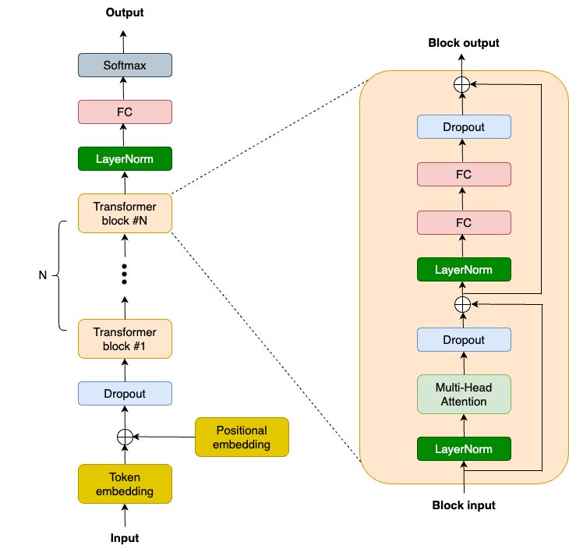
GPT2 architecture
Notes:
We’ll start with a model. Let’s use the transformer block in the GPT2 model as an example. This is the architecture diagram. Let’s go from bottom up. We have the token and positional embedding layers, a dropout layer, then a bunch of transformer layers stacked together, followed by a layernorm, a linear layer, and finally a softmax.

Slide 37
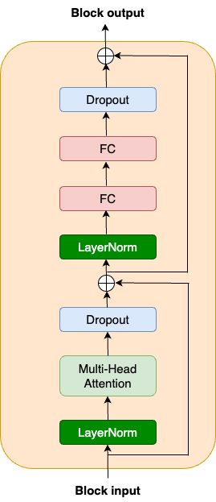
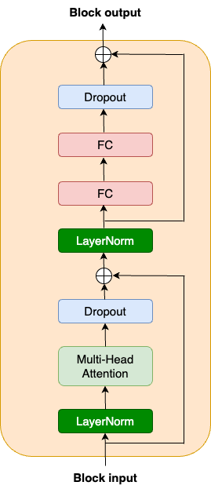
Transformer block
class TransformerBlock(nnx.Module):
def __init__(self, embed_dim: int, num_heads: int, ff_dim: int,
dropout_rate: float, rngs: nnx.Rngs):
self.layer_norm1 = nnx.LayerNorm(
epsilon=1e-6,
num_features=embed_dim,
rngs=rngs)
self.mha = nnx.MultiHeadAttention(
num_heads=num_heads,
in_features=embed_dim,
rngs=rngs)
self.dropout1 = nnx.Dropout(rate=dropout_rate)
......
Notes:
We’re splitting the block in half, so that the code is easier to read. We’ll structure this as an nnx.Module and focus first on the __init__. First, we define a layer norm, followed by a multi-head attention layer, and a dropout. NNX has a built-in multi-head attention layer, so we’ll just use that without doing q/k/v and all that kind of fun stuff.

Slide 38

Transformer block (cont’d)
class TransformerBlock(nnx.Module):
def __init__(self, embed_dim: int, num_heads: int, ff_dim: int,
dropout_rate: float, rngs: nnx.Rngs):
......
self.layer_norm2 = nnx.LayerNorm(epsilon=1e-6,
num_features=embed_dim,
rngs=rngs)
self.linear1 = nnx.Linear(in_features=embed_dim,
out_features=ff_dim,
rngs=rngs)
self.linear2 = nnx.Linear(in_features=ff_dim,
out_features=embed_dim,
rngs=rngs)
self.dropout2 = nnx.Dropout(rate=dropout_rate)
Notes:
Still in the transformer block, another layer norm, followed by up and down projections using two fully connected (FC) layers. Then a second dropout before the residual connection and block output.

Slide 39
Transformer block (cont’d)
class TransformerBlock(nnx.Module):
def __call__(self, inputs, training: bool = False):
input_shape = inputs.shape
bs, seq_len, emb_sz = input_shape
attention_output = self.mha(
inputs_q=self.layer_norm1(inputs),
mask=causal_attention_mask(seq_len), decode=False,
)
x = inputs + self.dropout1(attention_output,
deterministic=not training)
(… to be continued)
Notes:
So that was the __init__() function. The __call__() function is where we put everything together for the transformer block. As you can see, it’s literally less than 10 lines of code. Nice and easy.

Slide 40
Transformer block (cont’d)
# MLP
mlp_output = self.linear1(self.layer_norm2(x))
mlp_output = nnx.gelu(mlp_output)
mlp_output = self.linear2(mlp_output)
mlp_output = self.dropout2(mlp_output, deterministic=not training)
return x + mlp_output
Notes:
Here’s the __call__ section for the MLP.

Slide 41
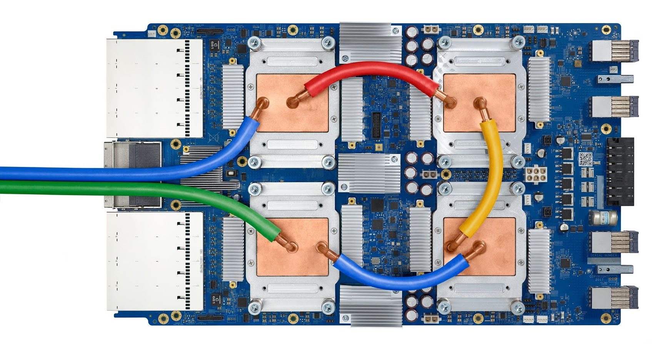
4 TPU chips
2 core per chip
TPU v3
Notes:
Since we want to leverage parallelism to train our model, let’s talk about TPU for a minute. Let’s take TPU v3 for example. Here is a TPU v3 board. There are 4 TPU chips here, each of which has 2 separate cores.

Slide 42
Transformer block sharding
mesh = Mesh(mesh_utils.create_device_mesh((4, 2)),
('batch', 'model'))
class TransformerBlock(nnx.Module):
def __init__(self, embed_dim: int, num_heads: int, ff_dim: int,
dropout_rate: float, rngs: nnx.Rngs):
self.layer_norm1 = nnx.LayerNorm(epsilon=1e-6,
num_features=embed_dim,
scale_init=nnx.with_partitioning(
nnx.initializers.ones_init(),
NamedSharding(mesh, P('model'))),
bias_init=nnx.with_partitioning(
nnx.initializers.zeros_init(),
NamedSharding(mesh, P('model'))),
rngs=rngs)
Notes:
Now the question is: how do we leverage all 8 TensorCores together? Well, NNX makes it very easy. For the transformer block we just built, we need to first define a hardware mesh. Think of the mesh as a 2D matrix of accelerators. In this case, we define 2 axes - the ‘batch’ axis and the ‘model’ axis. So in total we have 4 by 2, which is 8 cores. To scale bigger or smaller, we just need to change the mesh and the sharding and communication just follows. Now for each layer within the transformer block, we just need to specify how the parameters or weights should be sharded. For example, in the layer norm, we shard the weights along the ‘model’ axis.

Slide 43
Transformer block sharding
self.mha = nnx.MultiHeadAttention(
num_heads=num_heads,
in_features=embed_dim,
kernel_init=nnx.with_partitioning(
nnx.initializers.xavier_uniform(),
NamedSharding(mesh,
P(None, 'model'))),
bias_init=nnx.with_partitioning(
nnx.initializers.zeros_init(),
NamedSharding(mesh, P('model'))),
rngs=rngs)
self.dropout1 = nnx.Dropout(rate=dropout_rate)
Notes:
In the MultiHeadAttention layer, because the kernel weights are 2D, we shard the 2nd dimension along the ‘model’ axis.

Slide 44
Transformer block sharding (continued)
self.linear1 = nnx.Linear(in_features=embed_dim,
out_features=ff_dim,
kernel_init=nnx.with_partitioning(
nnx.initializers.xavier_uniform(),
NamedSharding(mesh, P(None, 'model'))),
bias_init=nnx.with_partitioning(
nnx.initializers.zeros_init(),
NamedSharding(mesh, P('model'))), …)
self.linear2 = nnx.Linear(in_features=ff_dim,
out_features=embed_dim,
kernel_init=nnx.with_partitioning(
nnx.initializers.xavier_uniform(),
NamedSharding(mesh, P(None, 'model'))),
bias_init=nnx.with_partitioning(
nnx.initializers.zeros_init(),
NamedSharding(mesh, P('model'))), …)
Notes:
We do the same for the 2 linear layers as well. Once we shard the model, JAX will automatically run the model in parallel and insert communication collectives as needed. We don’t need to do additional work. And that’s it for the transformer block! We also need to shard layers outside of the transformer blocks as well, but we’re going to skip those since you already get the idea.

Slide 45
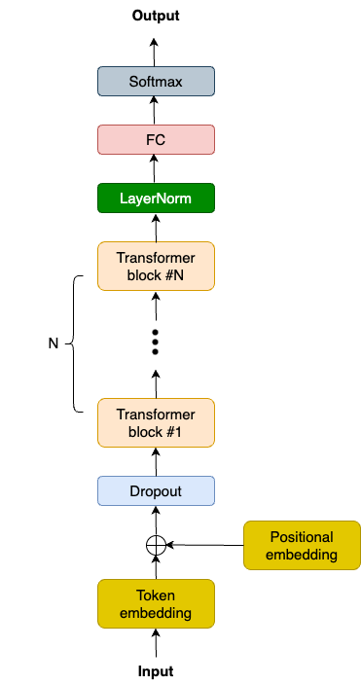
Data parallelism in the training loop
while True:
input_batch, target_batch = get_batch("train")
train_step(model, optimizer, train_metrics,
jax.device_put((input_batch, target_batch),
NamedSharding(mesh, P('batch', None))))
1
2
3
4
Notes:
One option for making training go faster is to use data parallelism. Remember the mesh we defined before? So far we have only used the ‘model’ axis when we sharded the model weights, but we haven’t used the ‘batch’ axis yet. To enable data parallelism, we use jax.device_put() to shard the batched training data along the ‘batch’ axis and feed it to the TPUs. Once we do this, we can leverage all 8 cores and run the model in parallel. Or to scale up or down we just change the mesh, and the rest follows.

Slide 46
Switching among different parallelisms (8 devices)
# 4-way batch data parallelism and 2-way model parallelism
mesh = Mesh(mesh_utils.create_device_mesh((4, 2)), ('batch', 'model'))
# 2-way batch data parallelism and 4-way model parallelism
mesh = Mesh(mesh_utils.create_device_mesh((2, 4)), ('batch', 'model'))
# Pure model parallelism
mesh = Mesh(mesh_utils.create_device_mesh((1, 8)), ('batch', 'model'))
# Pure batch data parallelism
Mesh = Mesh(mesh_utils.create_device_mesh((8, 1)), ('batch', 'model'))
Notes:
Thinking about how we can use our 8 devices, we have several options. When we created the mesh in our example so far, we used 4-way data parallelism and 2-way model parallelism. It turns out switching to other parallelism schemes is very easy. You just need to change how the axes are defined in order to use, say 2-way data parallelism, 4-way model parallelism, or 8-way model parallelism, or pure data parallelism. That’s a one line change to our code.

Slide 47
References
JAX: https://jax.dev
Flax NNX: https://flax.readthedocs.io
JAX AI Stack: https://jaxstack.ai
Grain Documentation: https://google-grain.readthedocs.io
Orbax: https://orbax.readthedocs.io
Notes:
Here’s some links for learning more about JAX, Flax NNX, the JAX AI Stack, Grain, and Orbax.

Slide 48

Please tell us what you think about this training
Please fill out a quick survey for us at
https://goo.gle/jax-training-feedback

